Slide 1

Major Project Review – 3
On
Design and Analysis of Artificial Magnetic Conductor (AMC) For 5G Communications
By
SANTHOSH .M.N – RA1911004010026
ASHIK MEHIR .T – RA1911004010039
JABEZ SOLOMON .J – RA1911004010045
Under the Guidance of
Dr. S. Bashyam
Assistant Professor, Department of ECE

Slide 2
INDEX
ABSTRACT
OBJECTIVE
INTRODUCTION
PROBLEM STATEMENT
LITERATURE SURVEY
NOVELTY
PROPOSED STRUCTURE
METHODOLOGY
FLOWCHART / ALGORITHM
RESULTS
PUBLICATION STATUS
CONCLUSIONS
REFERENCES

Slide 3
ABSTRACT
The Artificial Magnetic Conductor (AMC) is an equivalent magnetic conductor with a limited bandwidth and it works as an ideal equivalent magnetic conductor just at a fixed frequency. The geometry of the AMC unit cell is a square patch with four rectangular slots and a square ring. The AMC is printed on an FR4 substrate with a thickness of 3.2 mm, in the dimension of 9.6mm x 9.6mm x 3.2mm and with a relative permittivity of 4.4 and loss tangent of 0.003. The meta-surface is designed based on the split-ring resonator copper strip combined unit cells forming an array of the artificial magnetic conductor (AMC). The bottom surface of the substrate is the metal ground. In order to achieve single resonance, a square ring with copper strips is added, and consequently an band centered at a resonant frequency of 3.5 GHz can be achieved by the final single-band AMC. The proposed design is simulated by ANSYS HFSS electronic desktop 2016.1.

Slide 4
OBJECTIVE
To design a compact Artificial Magnetic Conductor (AMC) unit cell for 5G communication band (n78 band – 3.3 – 3.8 GHz).
To design a compact monopole antenna for 5G communication.
To enhance the antenna gain performance using 3 x 3 AMC patch.

Slide 5
INTRODUCTION
Designing of an Artificial Magnetic Conductor (AMC) which is used to prevent the interruption of 5G frequencies in the Flight’s Altimeter.
AMCs are engineered structures that can be optimized to provide specific electromagnetic responses over a wide range of frequencies.
One of the key features of AMCs is their ability to suppress or control electromagnetic waves over a wide range of frequencies. This makes them suitable for a variety of applications, including wireless communication systems, electromagnetic interference (EMI) shielding, and antenna design.

Slide 6
PROBLEM STATEMENT
In 5G communications the Radio Frequencies (RF) radiation is high compared to other wireless communication systems.
To reduce the radiation the Artificial Magnetic Conductor (AMC) structure can be used for shielding effect.
These are used to filter the signals based on their frequencies.
The concern is that the signal emitted by the 5G's C-Band will interfere with the signals the altimeter receives about the plane's altitude, which could impact operations during low-visibility landings or landings in bad weather.

Slide 7
LITERATURE SURVEY
Paper Title | Author | Contribution | Inference
A Low-Profile Broadband Dual-Polarized Base Station Antenna Array With Well-Suppressed Cross-Polarization | Chenyang Liao, Chao-Hai Du | A low-profile dual-band dual-polarized antenna with an artificial magnetic conductor (AMC) reflector is proposed for 5G communications. | By adopting a AMC reflector instead of a conventional perfect electric conductor (PEC) reflector, the distance between the radiator and the reflector can be reduced
A Dual-Polarized Frequency-Reconfigurable Low-Profile Antenna With Harmonic Suppression for 5G Application | Zhenghang Nie, Huiqing Zhai | A dual-polarized frequency-reconfigurable lowprofile antenna with harmonic suppression and backed with AMC for 5G application | The AMC with 0° reflection phase can improve the directivity of omnidirectional antenna and reduce profile. Through simulation, it is found that broadband AMC needs a very thick dielectric layer to achieve broadband performance

Slide 8
LITERATURE SURVEY
Paper Title | Author | Contribution | Inference
Miniaturization of Dielectric Resonator Antenna by Using Artificial Magnetic Conductor Surface | Hazrat Ali, Mohsen Khalily, Shahid Khan, Syed Usman Ali Shah, Jalil Ur Rehman Kazim, Haider Ali, Camel Tanougast | In this work, a dielectric resonator antenna (DRA) is miniaturized by using Artificial Magnetic conductor (AMC) surface without disturbing other important parameters. | Without changing the basic characteristic of the antenna such as gain, resonance frequency and efficiency, it is found that this simple technique highly reduces the DR volume (85%) and ground surface (15.5%) while maintaining the overall performance of the square DRA.
Wideband Gain Enhancement of an AMC Cavity-Backed Dual-Polarized Antenna | Shuhui Yang, , Longfei Liang, Wensong Wang, Yuanjin Zheng | A novel low-profile wideband antenna is proposed with high-gain, high-isolated, dual-polarized properties and backed with AMC. | The gain is mainly improved by the wideband AMC of the cavity. where the realized gain is 8.34-10.96 dBi and the radiation efficiency is more than 81.8%.

Slide 9
REALISTIC CONSTRAINTS
The AMC should be designed to operate across the frequency bands of interest with high reflection efficiency and low losses.
The size of the AMC is an important constraint, as it needs to be small enough to integrate into 5G devices such as smartphones and tablets. The design of the AMC should take into account the size constraints of the 5G device and the desired frequency range.
The AMC should be compatible with the other components of the 5G communication system, including the RF circuitry and the antenna design. The design of the AMC should take into account the impedance and radiation characteristics of the antenna.
The cost of the AMC is an important factor to consider, as it needs to be affordable for widespread deployment in 5G networks. The AMC design should be optimized for low cost and manufacturability.
The AMC should be designed to withstand the environmental factors such as temperature, humidity, and vibration that the 5G devices might encounter during its life cycle.
Overall, the AMC design needs to balance the above constraints to ensure a reliable and cost-effective 5G communication system.

Slide 10
NOVELTY
A new metallic compact AMC unit cell.
Reduced Substrate Length which leads to overall reduction in the size.

Slide 11
DIMENSIONS
Parameters | Values (mm) | Parameters | Values (mm)
L1 | 9.6 | S3 | 0.2
L2 | 9.2 | L | 20
L3 | 8.2 | W | 26
L4 | 3.8 | W1 | 45
L5 | 3.4 | A | 45
L6 | 10.8 | F | 11.8
S1 | 0.2 | Fw | 3
S2 | 0.2 | B | 41.3

Slide 12
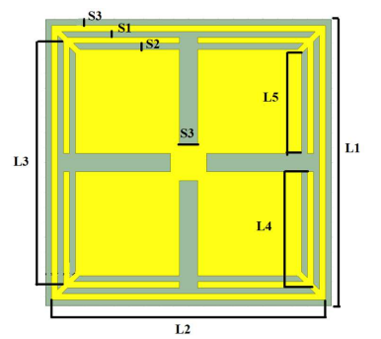
PROPOSED STRUCTURE
Proposed AMC Unit Cell

Slide 13
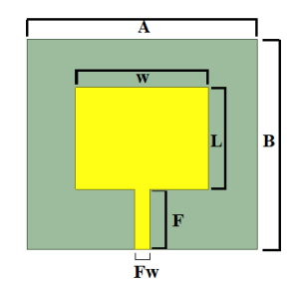
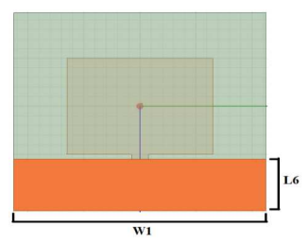
PROPOSED STRUCTURE
Proposed Patch Antenna

Slide 14
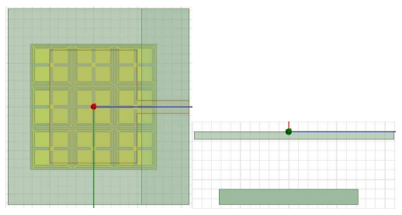
PROPOSED STRUCTURE
Proposed Antenna backed with AMC

Slide 15
METHODOLOGY
Choose a simulation software, such as HFSS, CST, or Ansoft Designer.
Determine the frequency range of interest.
Create a new 3D design with appropriate dimensions for the frequency range.
Add a metal layer to the design and apply a periodic boundary condition on it.
Define the properties of the metal using the Material Library in the simulation software.
Place perfect electric conductor (PEC) boundary conditions on the other surfaces of the design.
Set the frequency range of interest in the Excitation/Far-Field setup.

Slide 16
METHODOLOGY
Run a frequency sweep simulation to calculate the scattering parameters.
Extract the S-parameters and plot the reflection degree to determine the frequency response of the AMC.
Modify the metal layer geometry and/or properties to achieve the desired response.
Repeat steps until the desired AMC response is achieved.

Slide 17
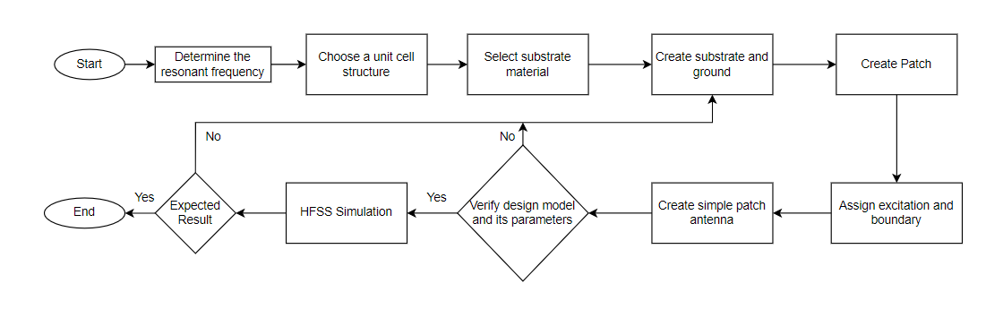
FLOWCHART / ALGORITHM

Slide 18
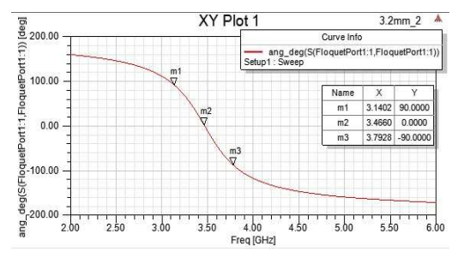
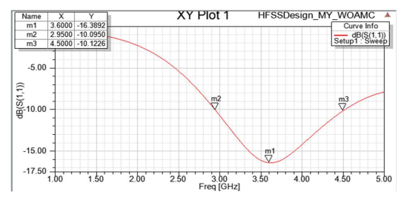
RESULTS
Output for AMC Unit Cell
Output for Patch Antenna

Slide 19
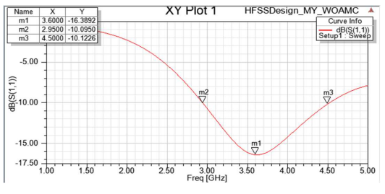
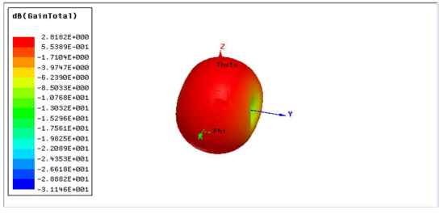
RESULTS
S11 parameter of simple patch antenna
Radiation pattern of simple patch antenna

Slide 20
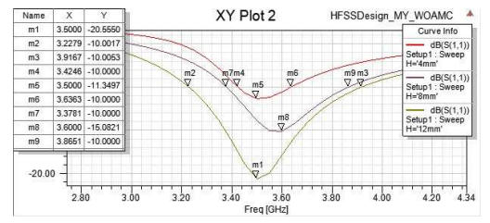
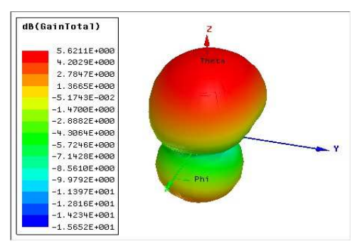
RESULTS
S11 parameter of simple patch antenna backed with AMC
Gain of the patch antenna backed with AMC

Slide 21
PUBLICATION STATUS
Our Paper titled “Design and Analysis of Artificial Magnetic Conductor (AMC) for 5G Communication” has been accepted and waiting for the presentation.

Slide 22
CONCLUSIONS
Thus, AMCs have become an important tool for the design and optimization of a wide range of electromagnetic systems and applications. Their ability to suppress or control electromagnetic waves over a wide range of frequencies.
The size of the unit cell is 9.6mm x 9.6mm x 3.2mm.
The gain of the monopole antenna is 2.81 dB without AMC and when AMC is used the gain is improved to 5.62 dB.
The demo model has been designed for 3.5 GHz and modified to get a compact size.

Slide 23
REFERENCES
B. Wang, C. Liao and C. -H. Du, "A Low-Profile Broadband Dual-Polarized Base Station Antenna Array With Well-Suppressed Cross-Polarization," in IEEE Transactions on Antennas and Propagation, vol. 69, no. 12, pp. 8354-8365, Dec. 2021, doi: 10.1109/TAP.2021.3083728.
Z. Nie, H. Zhai, L. Liu, J. Li, D. Hu and J. Shi, "A Dual-Polarized Frequency-Reconfigurable Low-Profile Antenna With Harmonic Suppression for 5G Application," in IEEE Antennas and Wireless Propagation Letters, vol. 18, no. 6, pp. 1228-1232, June 2019, doi: 10.1109/LAWP.2019.2913170.

Slide 24
REFERENCES
S. Yang, L. Liang, W. Wang, Z. Fang and Y. Zheng, "Wideband Gain Enhancement of an AMC Cavity-Backed Dual-Polarized Antenna," in IEEE Transactions on Vehicular Technology, vol. 70, no. 12, pp. 12703-12712, Dec. 2021, doi: 10.1109/TVT.2021.3119643.
Ali Abdulateef Abdulbari, Sharul Kamal Abdul Rahim, Firas Abedi, Ping Jack Soh, Ali Hashim, Rami Qays, Sarosh Ahmad, Mohammed Yousif Zeain, "Single-Layer Planar Monopole Antenna-Based Artificial Magnetic Conductor (AMC)", International Journal of Antennas and Propagation, vol. 2022, Article ID 6724175, 9 pages, 2022.

Slide 25
REFERENCES
S. Khan et al., "Miniaturization of Dielectric Resonator Antenna by Using Artificial Magnetic Conductor Surface," in IEEE Access, vol. 8, pp. 68548-68558, 2020, doi: 10.1109/ACCESS.2020.2986048.
R. Dewan, M. K. A. Rahim, M. R. Hamid, H. A. Majid and M. F. M. Yusoff, "Ultra-wideband antenna with tuneable Artificial Magnetic Conductor," 2014 International Symposium on Antennas and Propagation Conference Proceedings, Kaohsiung, Taiwan, 2014, pp. 105-106, doi: 10.1109/ISANP.2014.7026552.
https://www.youtube.com/watch?v=0C37Zvy3Ubk
https://www.youtube.com/watch?v=yi2MmOE_nKo

Slide 26
THANK YOU

